Slide 1
Top 10 Top Rated Workplaces
indeed.com

Slide 2
About Top-Rated Workplaces
“Indeed's Top-Rated Workplace award highlights the best employers across a variety of categories that matter to job seekers — including employers who rank the highest in specific industries, locations, cultural values, professions, and more.”
Ranking calculation methodology
“Indeed uses a proprietary algorithm to rank companies using a variety of factors, such as average rating, number of reviews, and the history of job openings. But in general, companies with a large number of high ratings will place higher in the rankings.”

Slide 3
COMPANIES ATTRIBUTES
Adobe
Facebook
Southwest Airlines
Live Nation
Intuit
Costco Wholesale
Delta
eBay Inc.
Microsoft
Johnson & Johnson
Company Name
Company Rating
Review Title
Job Position Title
Location

Slide 4
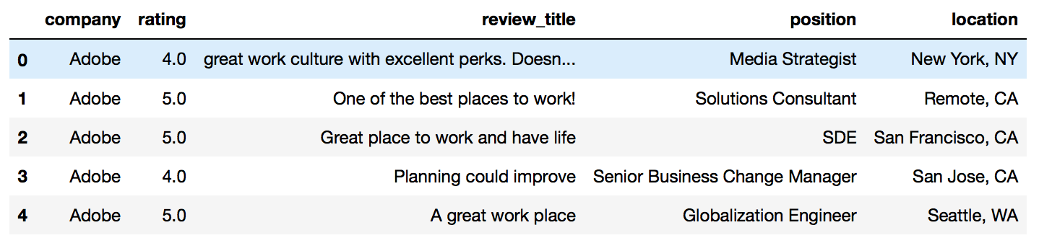
Consists of 20,965 rows of reviews
Missing 54 review titles

Slide 5
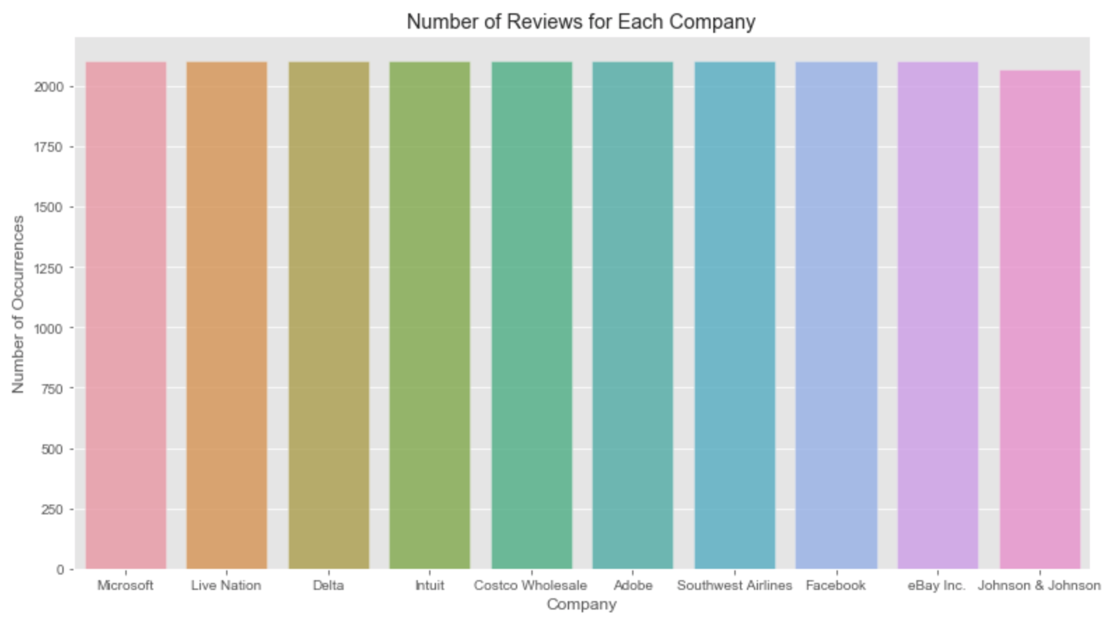

Slide 6
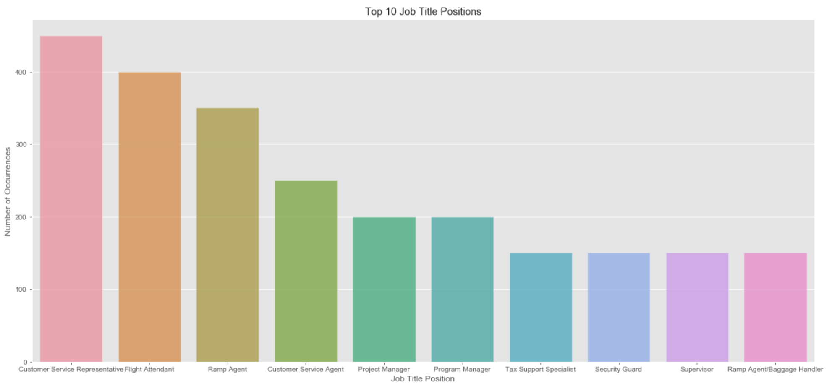

Slide 7
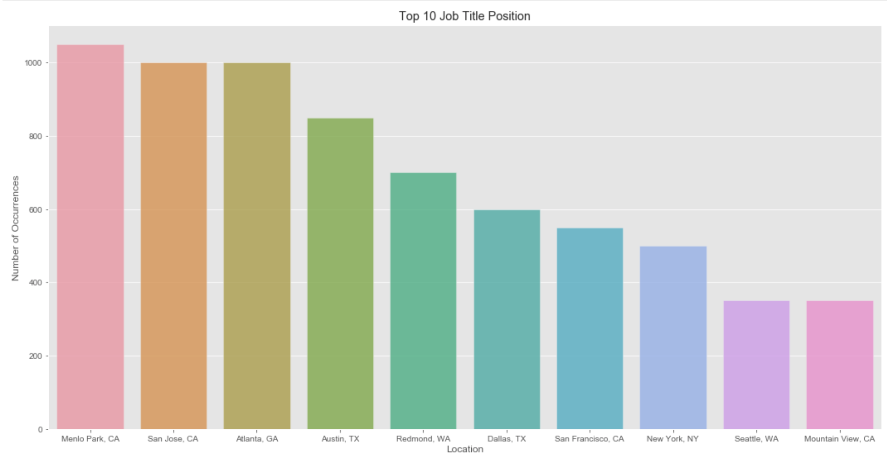

Slide 8
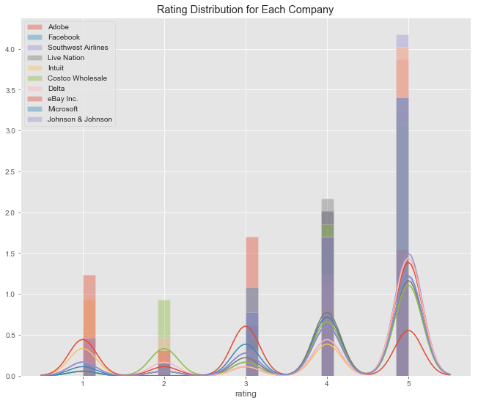
Rate distribution is Left-Skewed meaning the Median Rating > Mean Rating
Rate distribution for each company are similar

Slide 9
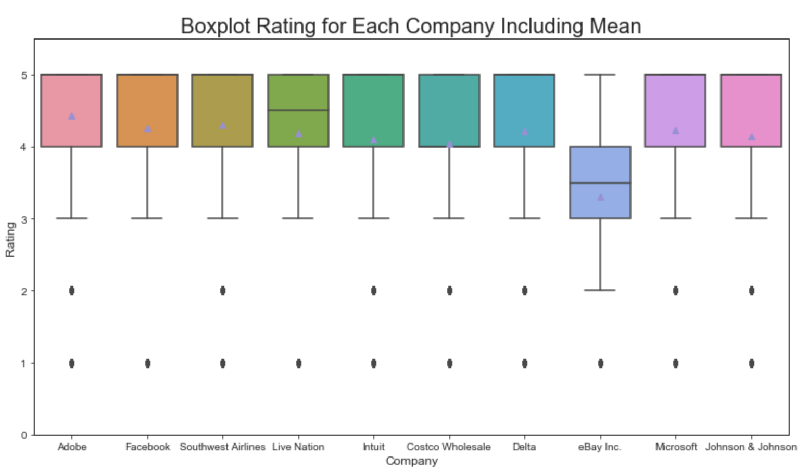
Box plots for each company showing distribution of rating are very similar except for eBay Inc.
Most ratings data are contained in the Interquartile Range for most companies except for ebay Inc
It seems ebay has more rating below 4 than other companies

Slide 10
Still Working On
Working on getting the top 5 job position titles for each Rating between 1 to 5 (accurately)
And also getting the companies and locations associated with the job position titles for each Rating
Need to improve job position titles

Slide 11
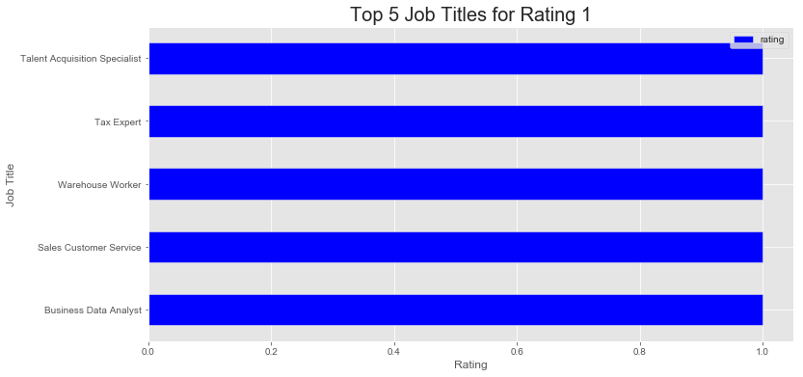

Slide 12
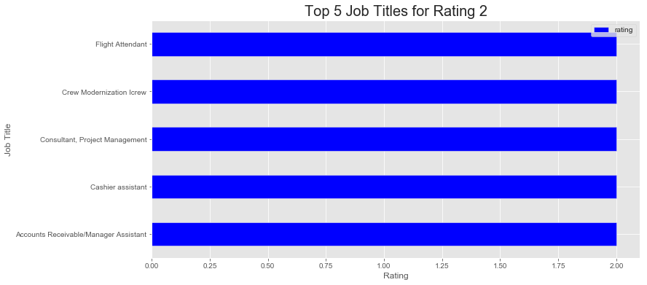

Slide 13
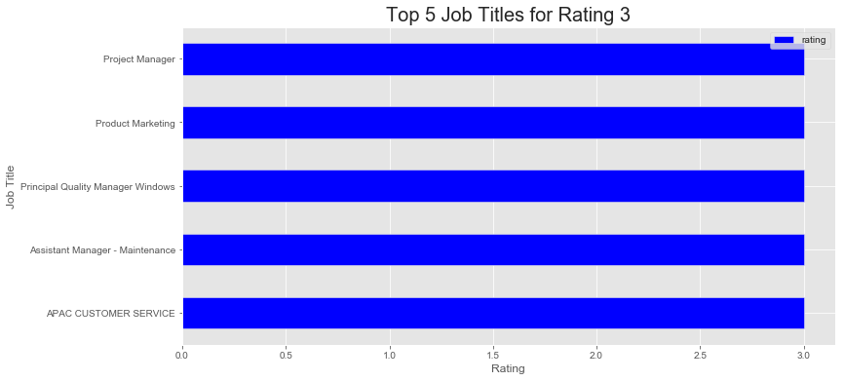

Slide 14
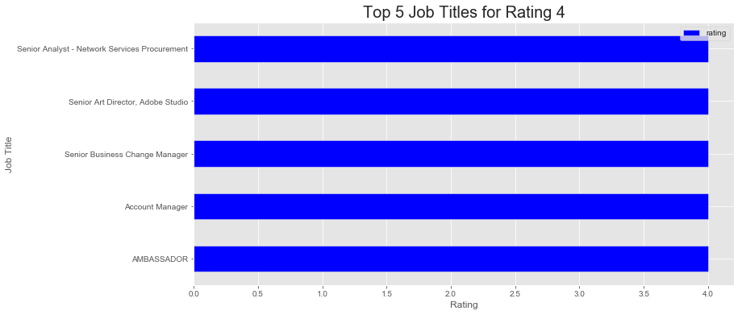

Slide 15
